Slide 1
Chapter # 4 : Programs and apps: Productivity, Graphs, Security and other Tools
Lecture # 12

Slide 2
Productivity Applications
Productivity applications can assist you in becoming more effective and efficient while performing daily activities at work, school, and home
Word processing
Presentation
Spreadsheet
Database
Note taking
Calendar and contact management
Project management
Accounting
Personal finance
Legal
Tax preparation
Document management
Enterprise computing
Page 165

Slide 3
Productivity Applications
With productivity applications, users often:
Create a project
Edit a project
Format a project
Save a project
Distribute a project
Pages 165 - 166

Slide 4
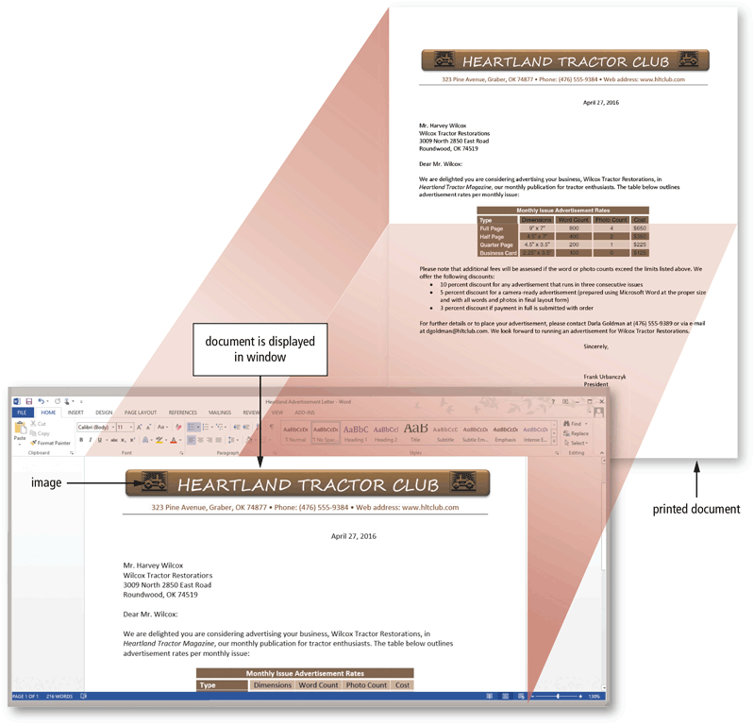
Productivity Applications
Word processing software allows users to create and manipulate documents
A major advantage of using word processing software is that it enables users to change their written words easily
Page 167
Figure 4-5

Slide 5

Productivity Applications
Presentation software allows users to create visual aids for presentations to communicate ideas, messages, and other information to a group
Page 168
Figure 4-6

Slide 6
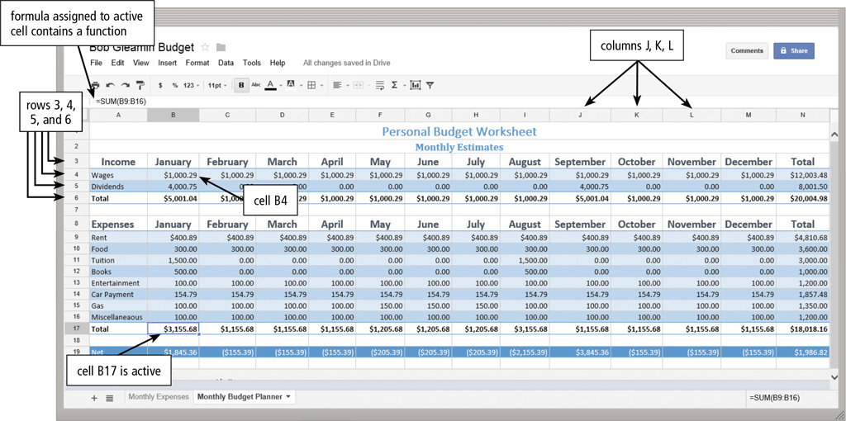
Productivity Applications
Spreadsheet software allows users to organize data in columns and rows and perform calculations on the data
Pages 168 - 169
Figure 4-7

Slide 7
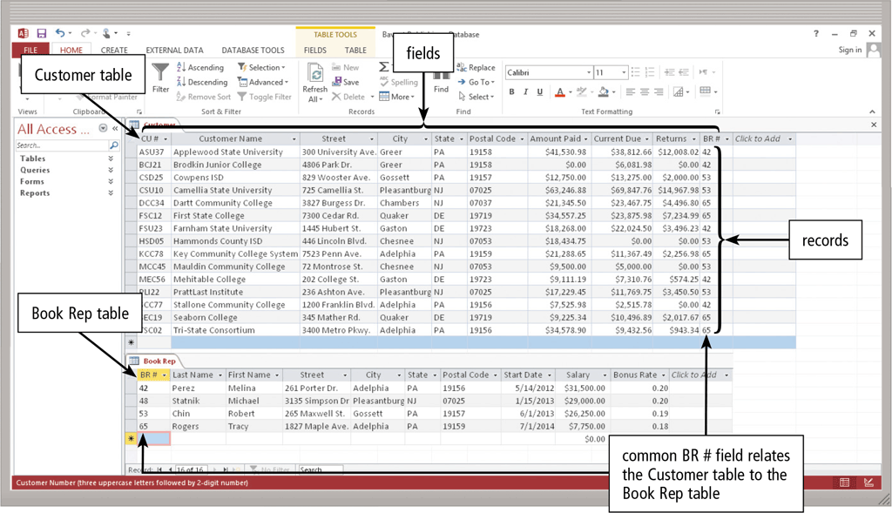
Productivity Applications
A database is a collection of data organized in a manner that allows access, retrieval, and use of that data
Database software allows users to create, access, and manage a database
Page 170
Figure 4-8

Slide 8
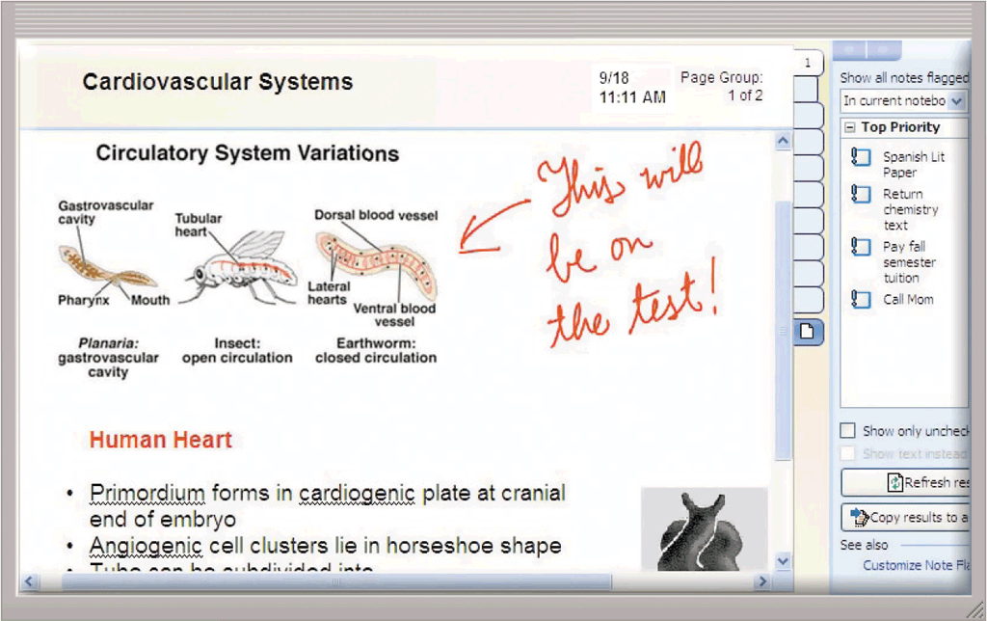
Productivity Applications
Note taking software is an application that enables users to enter typed text, handwritten comments, drawings, sketches, photos, and links anywhere on a page
Page 171
Figure 4-9

Slide 9
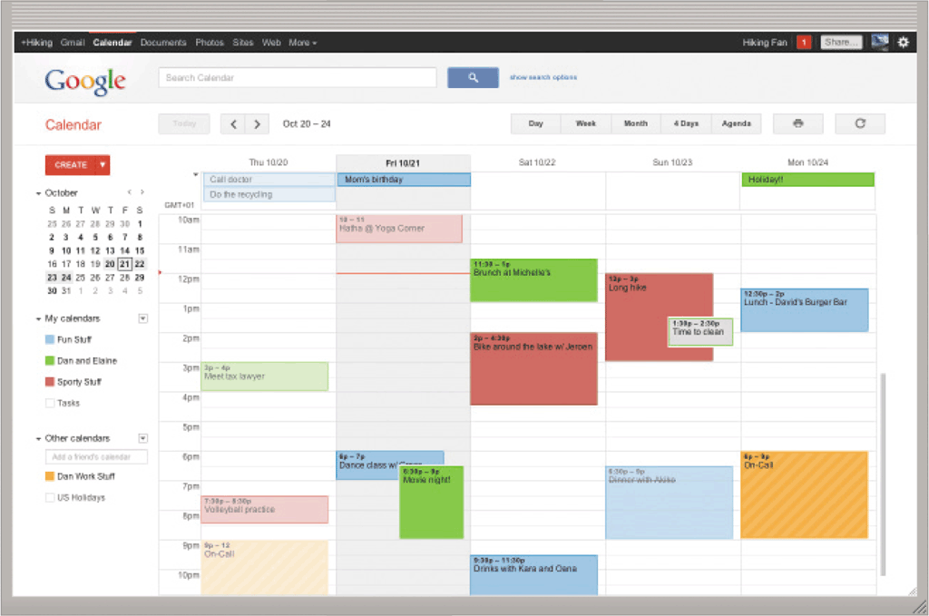
Productivity Applications
Calendar and contact management software is an application that helps you organize your calendar, keep track of contacts, and share this information with other users
Page 171
Figure 4-10

Slide 10
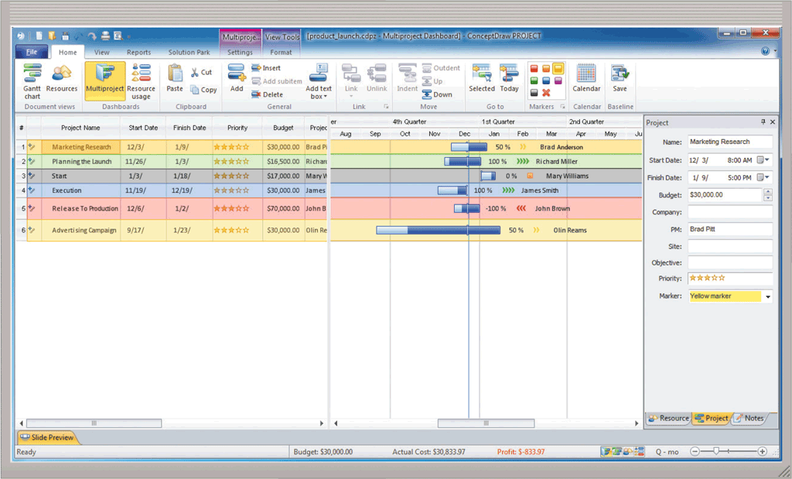
Productivity Applications
A software suite is a collection of individual related applications available together as a unit
Project management software is an application that allows a user to plan, schedule, track, and analyze the events, resources, and costs of a project
Page 172
Figure 4-11

Slide 11
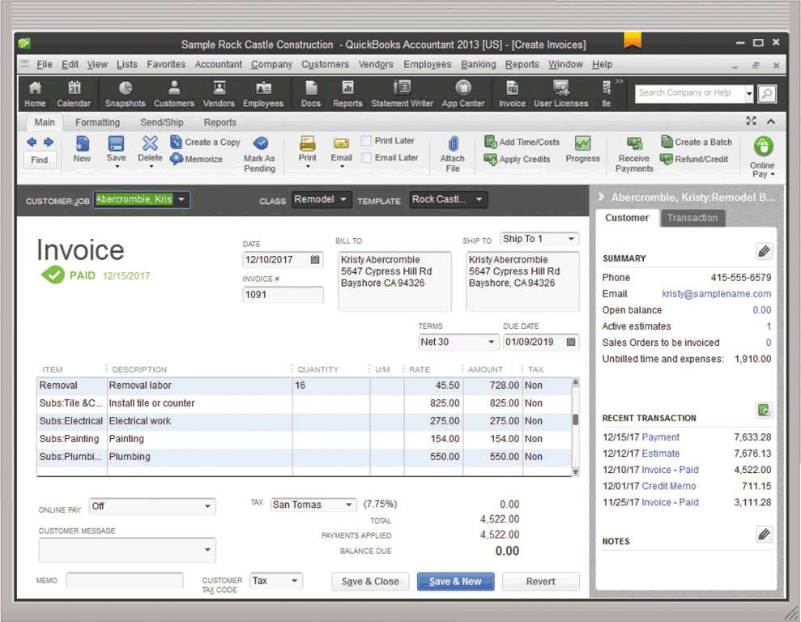
Productivity Applications
Accounting software is an application that helps businesses of all sizes record and report their financial transactions
Page 173
Figure 4-12

Slide 12
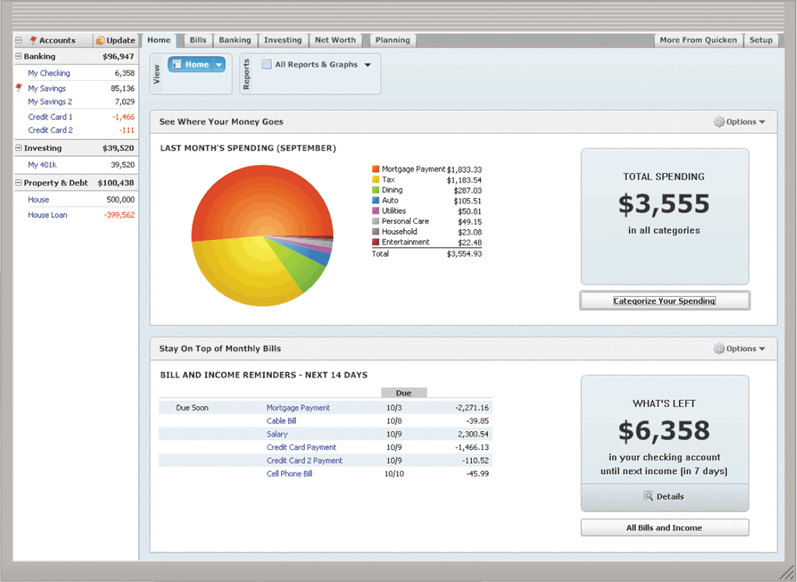
Productivity Applications
Personal finance software is a simplified accounting application that helps home users and small/home office users balance their checkbooks, pay bills, track personal income and expenses, verify account balances, transfer funds, track investments, and evaluate financial plans
Page 174
Figure 4-13

Slide 13
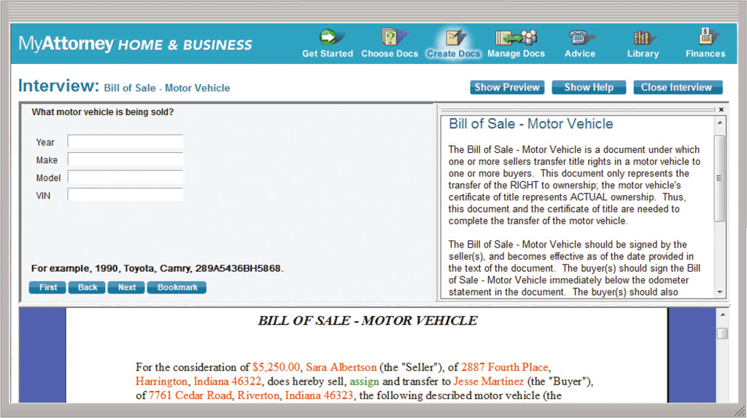
Productivity Applications
Legal software is an application that assists in the preparation of legal documents and provides legal information to individuals, families, and small businesses
Page 175
Figure 4-14

Slide 14
Graphics and Media Software
Computer-aided design (CAD) software
Desktop publishing software
Paint/Image editing software
Pages 180 – 181
Figures 4-17 – 4-19

Slide 15
Graphics and Media Software
Photo editing and photo management software
Video and audio editing software
Pages 181 – 183
Figures 4-20 – 4-21

Slide 16
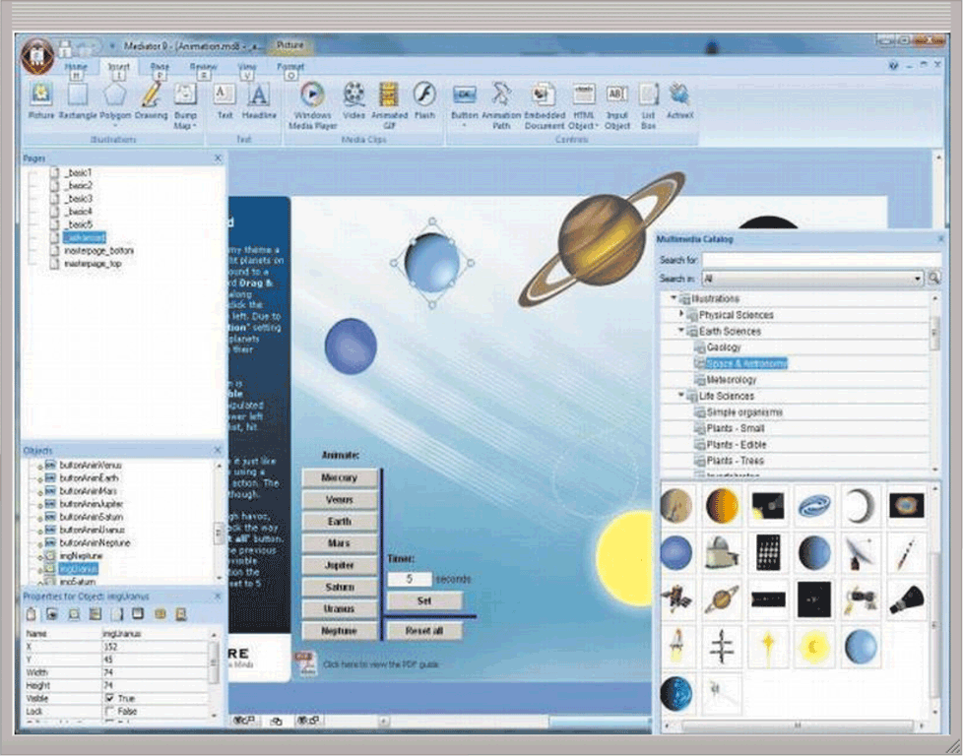
Graphics and Media Software
Multimedia authoring software allows users to combine text, graphics, audio, video, and animation in an interactive application
Website authoring software helps users of all skill levels create webpages that include graphics, video, audio, animation, and special effects with interactive content
Page 184
Figure 4-22

Slide 17
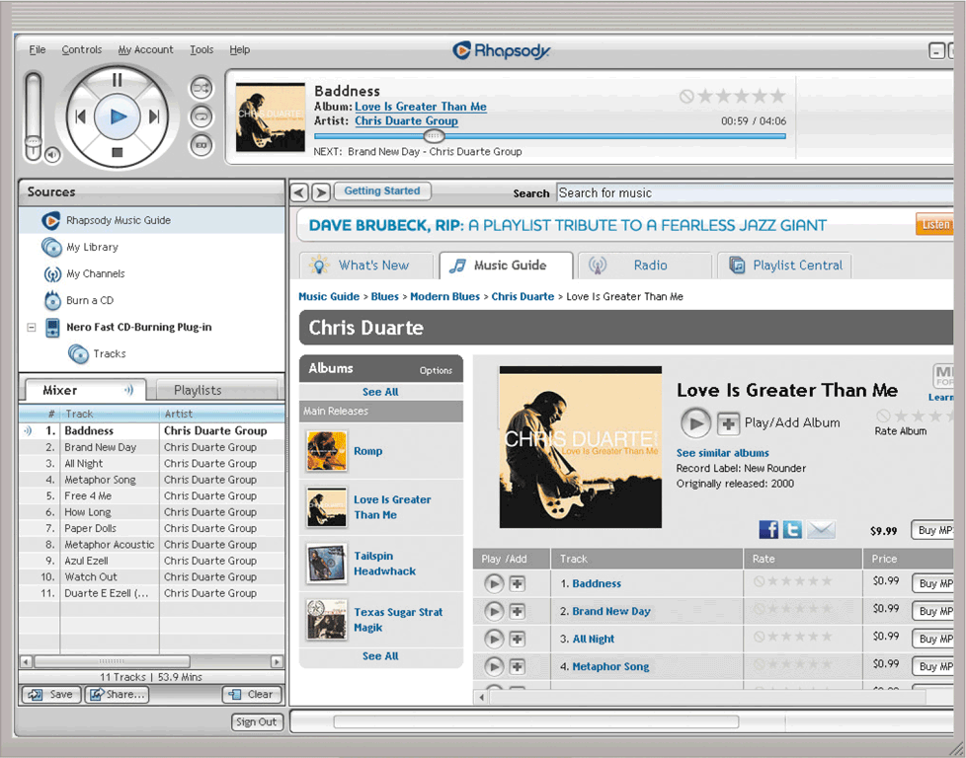
Graphics and Media Software
A media player is a program that allows you to view images and animations, listen to audio, and watch video files on your computer or mobile device
Disc burning software writes text, graphics, audio, and video files on a recordable or rewritable disc
Page 185
Figure 4-23

Slide 18
Personal Interest Applications
Lifestyle applications
Medical applications
Entertainment applications
Education applications
Pages 185 - 186

